Slide 1

Internet Of Things
Bsc.CSIT Group I-D
Presented To:
Ishan Timilsina
Presenters:
Bikash Paswan
Hemanta Pokharel
Hemant Bhandari
Puskar Dahal

Slide 2

Agenda
What is Internet Of Things ?
Why we need Internet of Things ?
How does Iot Work?
Applications
Example of Internet of Things
Conclusion

Slide 3
What is IoT ?
Internet of Things (IoT) is a concept or a technology which aims to connect all the devices to the internet and help them communicate with each other with or without human intervention.
The devices in IoT could be anything like TV, Refrigerator, Air Conditioner, mobile phones, your cars or even a person with heart monitor.

Slide 4
Why we need IoT ?
We are lazy
We want to automate everything
We want to control everything remotely
We want to see data in real time

Slide 5

How does IoT Works ?
IoT devices contain sensors and mini-computer processors for collecting real time data.
Each device has it own unique IP address to make the communication possible.
If every device are connected to the internet is it possible to assign a unique
IP to each of them?
To solve this problem IPV4 was replaced by IPV6 which gives unbelievable
amount of unique IP addresses.

Slide 6
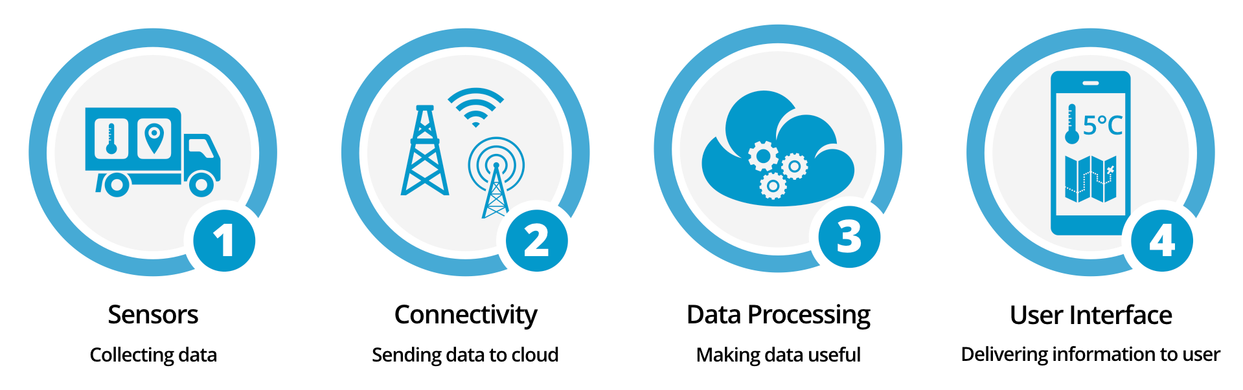
Data are collected from devices and stored on cloud which are analyzed to extract meaningful information form big data.
Processed data is delivered to the user.

Slide 7






Applications
Home Appliance
Smart Environment
Smart Vehicles
Smart Farming
Connected Devices
Smart Industry

Slide 8

Example
Simple Home Automation with Google Assistance and NodeMCU

Slide 9
Conclusion
While IoT is complex and poses some risk and is still evolving, many pioneers have started adopting this technology.
IoT can help innovative new process and initiatives that could transform business, lives and the world
We are also trying to understand what the many opportunities and challenges are going to be as more and more devices starts to join IoT.

Slide 10


